Slide 1
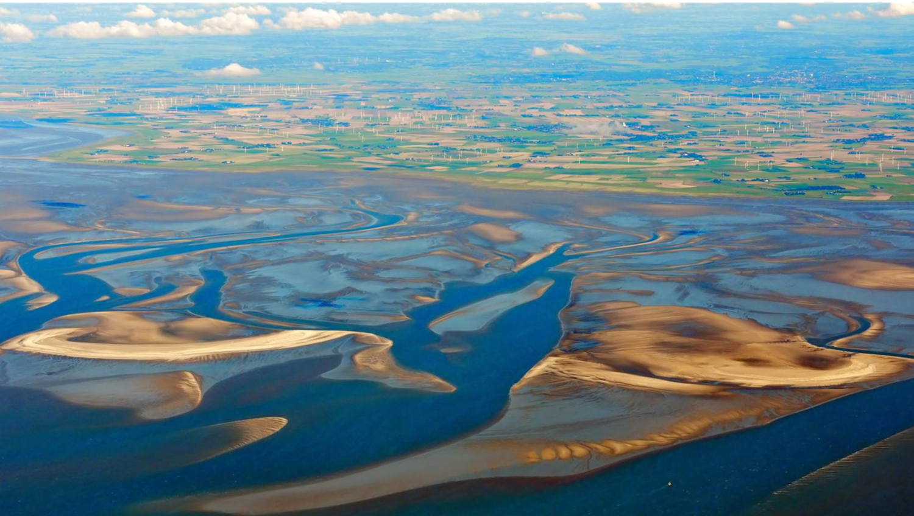
Transboundary Conservation Areas
Lesson 2: Typology of Transboundary Conservation Areas
Notes:
Photo credit: Nordfriesiche Wattenmeer ©Ralf Roletschek (CC BY-SA 3.0)
*Note that all of the photos in this presentation are of the Wadden Sea transboundary system, comprising the Dutch Wadden Sea Conservation Area, the German Wadden Sea National Parks of Lower Saxony and Schleswig-Holstein, and the Danish Wadden Sea Maritime Conservation Area.
Context and purpose of Lesson 2
This Lesson seeks to introduce Learners to the different types and models of Transboundary Conservation Areas (TBCAs). The purpose is to:
Help learners understand the nature and characteristics of different types of TBCAs
Share information and experiences on initiating, applying and developing transboundary conservation methods and models to relevant typologies of TBCAs
Supplemental Reading
IUCN WCPA Best Practice Guidelines Transboundary Conservation: A systematic and integrated approach (Pgs. 6-14)
IUCN Initiating effective transboundary conservation: a practitioner’s guideline based on the experience from the Dinaric Arc (Pgs. 6-8)
IUCN Guidelines for Protected Areas Legislation (PA Guidelines) (Pgs. 268-267, 283-288)

Slide 2
Factors of Success
Assess the enabling environment to pursue transboundary conservation
Define the transboundary context and relationships affecting the achievement of the conservation targets and the resulting geographic extent
Identify and involve stakeholders, obtain support of decision makers and ensure political will and buy-in
Agree on common values and joint vision
Determine common transboundary management objectives and develop cooperative agreements
Notes:
Photo credit: Nordfriesiche Wattenmeer ©Ralf Roletschek (CC BY-SA 3.0)
Factors of success
Recall the five factors of success in the process of initiating transboundary conservation:
1. Assess the enabling environment to pursue transboundary conservation
2. Define the transboundary context and relationships affecting the achievement of the conservation targets and the resulting geographic extent
3. Identify and involve stakeholders, obtain support of decision makers and ensure political will and buy-in
4. Agree on common values and joint vision
5. Determine common transboundary management objectives and develop cooperative agreements
Lesson 2 introduces key concepts, models and approaches relevant to all five factors.

Slide 3
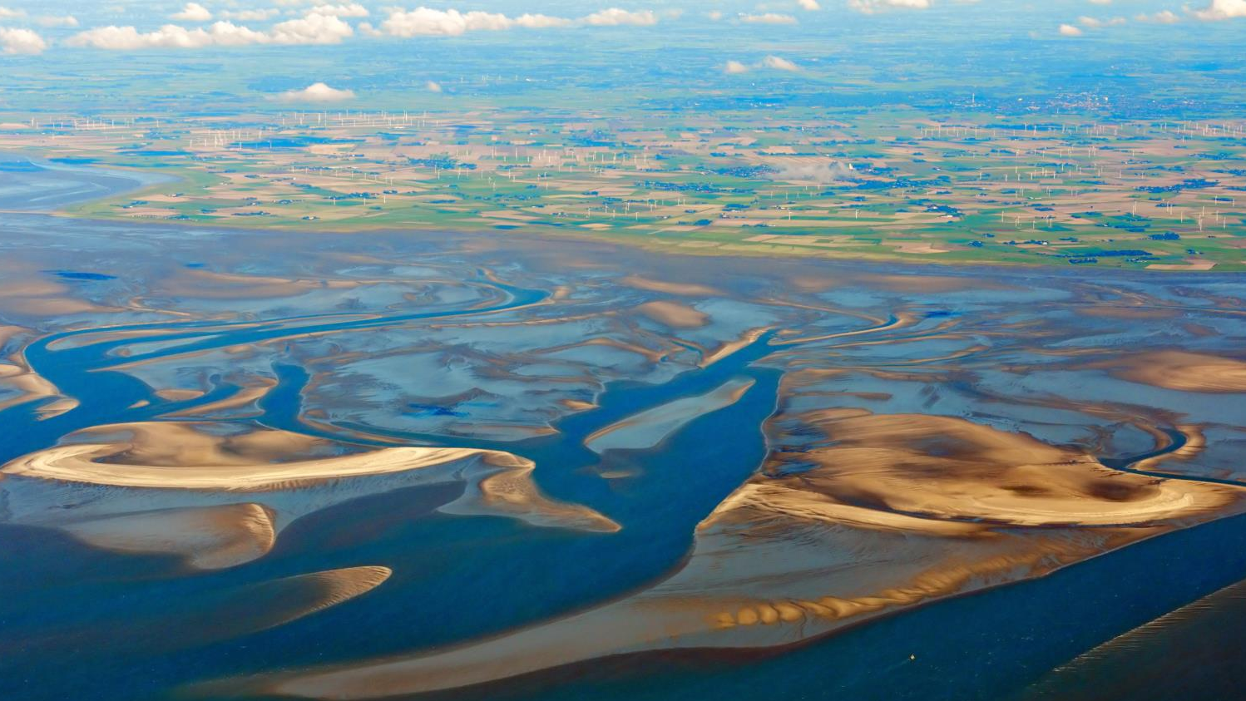

Lesson Overview & Goals
Typology of Transboundary Conservation Areas
Models of cooperation for initiating and developing TBCAs
Types of TBCAs
Understanding TBCA operations in practice
Notes:
Photo credit: Nordfriesiche Wattenmeer ©Ralf Roletschek (CC BY-SA 3.0)
Content overview
This Lesson will address:
Models of cooperation for initiating and developing TBCAs
Types of TBCAs
Understanding TBCA operations in practice

Slide 4
Transboundary cooperation
How does transboundary cooperation work? What are the methods or mechanisms for transboundary cooperation? Examples?
  …
Notes:
Photo credit: Nordfriesiche Wattenmeer ©Ralf Roletschek (CC BY-SA 3.0)
Discussion
Use this slide to start a discussion. Ask learners:
How does transboundary cooperation work?
What are the different methods or mechanisms for transboundary cooperation?
What are some examples of cooperation in different TBCAs?
Pause the slideshow and take notes on the slide itself to record learner’s responses. Duplicate the slide if you need more space. Afterwards, responses can be shared with learners.
On the next slide, you will evaluate the answers against models of cooperation.

Slide 5
Models of Cooperation in Transboundary Conservation Areas
Models of Cooperation
Communication or Information sharing
Joint implementation of decisions
Consultation
Coordinated action
Key Points
Models are not a hierarchy – various models are appropriate for different situations at different times
Models may be combined & adapted based on context and needs of the stakeholders
Cooperation can be through formal agreements or informal arrangements
Requires consideration of legal and institutional frameworks, management systems, languages, cultural backgrounds and political situation
Notes:
Photo credit: Nordfriesiche Wattenmeer ©Ralf Roletschek (CC BY-SA 3.0)
Models of cooperation in TBCAs
Transboundary cooperation can be discussed in different ways.
The IUCN WCPA Best Practice Guidelines set out four models of cooperation in TBCAs:
Communication or Infomation sharing
Consultation
Coordinated action
Joint implementation of decisions
Key points about IUCN models of cooperation:
Models are not a hierarchy – no model is superior or inferior to another. Instead, different or various models are appropriate for different situations at different times.
Models may be combined and adapted based on context and needs of stakeholders. The challenge is to match the model of cooperation with the needs, interests, and political and socio-economic circumstances of a particular TBCA. But more cooperation should always be encouraged.
Cooperation can be through formal agreements or informal arrangements. This will be discussed further in Lesson 4.
Requires consideration of parties’ respective laws and institutional frameworks, different management systems, compatible and incompatible databases and monitoring practices, diverse languages, cultures and religions, political tensions, and varied levels of economic performance.
Each model of cooperation will be discussed further on the next slides.
Models describe the mode of cooperation observed in existing TBCAs. For practitioners, they can be useful for making clear that there is a wide range of options how close or advanced cooperation can be, based on the context and needs of the site in question.
Instead of models of cooperation, some researchers use the terms pathways or levels of cooperation. While the term pathways of cooperation also describes the approach sufficiently, the term levels of cooperation implies a progression from lower to higher levels of engagement, which may not be appropriate.
Beyond cooperation in a specific TBCA, it may be appropriate to establish cooperation between and among TBCAs and other protected areas in the wider region. See Box 4 on p. 20 of the IUCN WCPA Best Practice Guidelines for an example of regional cooperation in the Barents region.

Slide 6

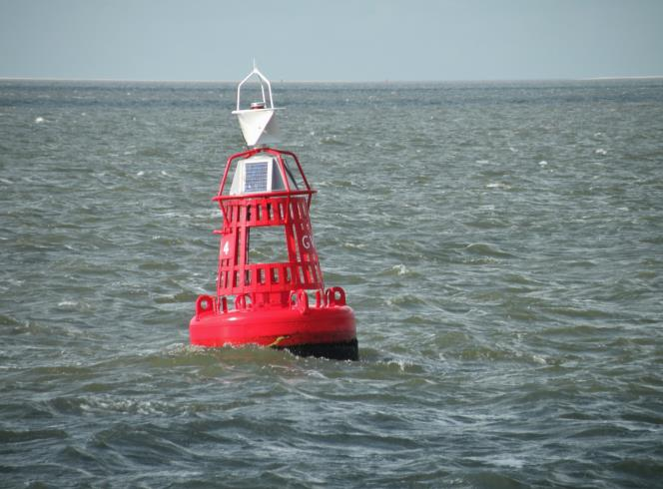
Model 1: Communication or Information Sharing
Regular communication on actions, problems, opportunities, issues
Sharing of information
Notification of management actions
Notes:
Photo credit: Boei in Waddenzee @Weefemwe (CC BY-SA 3.0)
Model 1: Communication or Information Sharing
Transboundary cooperation requires, at minimum, communication and sharing of information
This entails communication on actions, problems, opportunities or other relevant issues
It can also involve regular sharing of information, such as notifying about management actions in a particular site
Communication can be facilitated by modern technology, particularly where geographic limitations affect traditional communication
Examples of communication and information sharing initiatives in TBCAs can be found in the IUCN WCPA Best Practice Guidelines, which may be distributed as handouts:
Case study 4 on p. 33 describes the establishment of a Tele-Center for communication as an initiative of FORMADAT in the Heart of Borneo
Case study 5 on p. 37 describes the establishment of a transboundary radio communication system to facilitate joint law enforcement, tourism and emergency responses in the /Ai/Ais Richtersveld Transfrontier Park

Slide 7
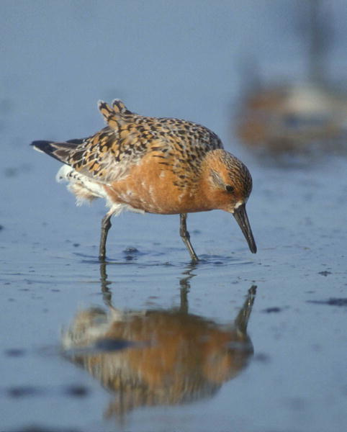
Model 2: Consultation
Seeking opinion, feedback, advice
Consulting to solve problems, improve management action
Cooperative process leading to harmonization of management
Notes:
Photo credit: Calidris-canutus @Jan van de Kam (CC BY 2.5)
Model 2: Consultation
Parties seek opinion, feedback and advice from each other
They consult on how to solve problems, how to improve management actions, etc.
The overall aim of this cooperative process is to harmonize management
Examples of consultation in TBCAs can be found in the IUCN WCPA Best Practice Guidelines, which may be distributed as handouts:
Box 8 on p. 28 describes cooperation leading to harmonization of management in the Kavango Zambezi (KAZA) in Angola, Botswana, Namibia, Zambia and Zimbabwe
Box 19 on p. 73 describes the consultations relevant for protected area management led between Phong Nha-Ke Bang and the Hin Nam No protected areas in Viet Nam and Lao

Slide 8

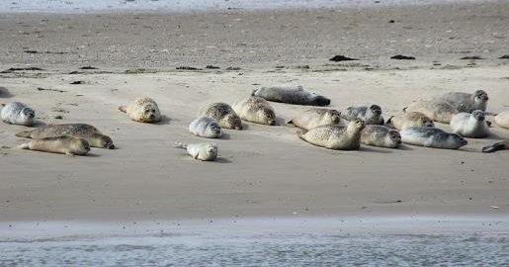
Model 3: Coordinated Action
Jointly coordinated management actions
Implemented within sovereign area of each party
Contribute to conservation goals of the transboundary ecosystem
Form of cooperative management
Notes:
Photo credit: Sea Gulls in flight Waddenzee @Ron Engelbert (CC BY 2.0) (top); Kegelrobben und Seehundkolonie @Netty3979 (CC BY-SA 4.0) (bottom)
Model 3: Coordinated Action
Jointly coordinated management actions
Implemented within sovereign area of each party
Contribute to conservation goals of the entire transboundary ecosystem
Considered to be a form of cooperative management
Example: monitoring of species and ecological processes is a regular activity on the territory of each party, but results contribute to conservation of species or ecosystems in the entire shared ecosystem
Examples of coordinated action in TBCAs can be found in the IUCN WCPA Best Practice Guidelines, which may be distributed as handouts:
Case study 7 on p. 53 desribes the Crown of the Continent initiative where coordinated action of many different stakeholders leads to help conserve Waterton-Glacier International Peace Park.
Case study 6 on p. 48 describes the European Green Belt Initiative, which provides a framework for pursuing coordinated conservation action and cooperative management of transboundary ecosystems. It is an initiative encompassing a large number of partners, regional and site-based initiatives, projects, and activities.

Slide 9

Model 4: Joint Implementation of Decisions
Jointly coordinated management actions
Jointly implemented across sovereign boundaries
Contribute to conservation goals of the transboundary ecosystem
Form of cooperative management
Notes:
Photo credit: Sonnenuntergang auf dem Kniepsand @Matthias Süßen (CC BY-SA 4.0)
Model 4: Joint Implementation of Decisions
Jointly coordinated management actions
Implemented jointly across the sovereign boundaries
Contribute to conservation goals of the entire transboundary ecosystem
Considered to be a form of cooperative management
Examples of joint implementation of decisions in TBCAs can be found in the IUCN WCPA Best Practice Guidelines, which may be distributed as handouts:
Box 6 on p. 24 notes joint law enforcement patrols established in a TBCA consisting of Cross River National Park in Nigeria and Takamanda National Park in Cameroon to safeguard Cross River gorilla
Case study 10 on p. 87 notes the establishment of joint anti-poaching patrols to support the law in Sangha Trinational in Cameroon, Central African Republic and the Republic of Congo
Case study 8 on p. 68 describes joint fundraising and project implementation in Marittime Alps-Mercantour TBCA, which is also relevant for joint production of marketing material that profiles TBCA as single entity
Box 1 on p. 9 features Lake Neusiedl / Seewinkel Fertő-Hanság National Park, which is an example for the production of joint marketing materials among other jointly coordinated actions
Box 16 on p. 67 describes a jointly implemented forest conservation project in the Emerald Triangle Protected Forests Complex shared by Cambodia, Laos and Thailand

Slide 10
Summary: Models of Cooperation
Model | Description
Communication or Information sharing | Regular communication on actions, problems, opportunities or other relevant issues Regular sharing of information, e.g. notifying about various management actions in a particular site
Consultation | Seeking opinion, feedback or advice from each other, e.g. on how to solve a problem, how to improve a management action, etc. Cooperative process with the aim to harmonize management
Coordinated action | Jointly coordinated management actions implemented within the sovereign areas of each party, that contribute to the conservation goals of the entire transboundary ecosystem Considered to be a form of cooperative management
Joint implementation of decisions | Jointly coordinated and implemented management actions across the sovereign boundaries Considered to be a form of cooperative management
Notes:
Photo credit: Nordfriesiche Wattenmeer ©Ralf Roletschek (CC BY-SA 3.0)
Summary: Models of cooperation
This slide provides a summary of the models of cooperation. It may be printed and given to participants as a handout.
Reminders
The models are not hierarchical – they should be matched to the needs and interests of each site
But in general, more cooperation should be encouraged
Usually some combination of models is used
Some actors use the terms levels or pathways of cooperation.
Levels implies a hierarchy or progression from less to more cooperation. In contrast, models are not hierarchical.
Pathways of cooperation are more similar to models in that they are not necessarily hierarchical
Functionally, the three terms are often used interchangeably
Discussion
Return to the discussion in slide 3
Do the mechanisms for cooperation discussed fit within these four models?
What experience do participants have with each of the four models?
When should they be used?
When might a certain model be preferred?

Slide 11
Typology of Transboundary Conservation Areas
Typology of TBCAs
Three common characteristics of TBCAs
Cooperation between two or more countries
Existance of international boundaries
Dedication to conservation goals
Transboundary Protected Area (TBPA)
Transboundary Conservation Landscape and/or Seascape (TBCL/S)
Transboundary Migration Conservation Area (TBMCA)
Special Designation
Park for Peace
Notes:
Photo credit: Nordfriesiche Wattenmeer ©Ralf Roletschek (CC BY-SA 3.0)
Typology of TBCAs
There are many different types of TBCAs, as introduced in Lesson 1.
The IUCN WCPA revised a typology of TBCAs and introduced it in IUCN WCPA Best Practice Guidelines in 2015 (see below for notes on the history of the typology).
The new typology includes three types of TBCAs and a special designation:
Type 1: Transboundary Protected Area (TBPA)
Type 2: Transboundary Conservation Landscape and/or Seascape (TBCL/S)
Type 3: Transboundary Migration Conservation Area (TBMCA)
Special designation: Park for Peace (can be applied to any of the three types)
All TBCAs share common characteristics, regardless of type:
Cooperation between parties from two or more countries
Existance of international boundaries, following one or more of the models discussed above
Dedicated to conservation goals
The following slides provide more detail on each of the types, and examples of each type.
Note on the history of the IUCN Typology of TBCAs:
The current typology reflects developments in current understanding of protected areas and transboundary conservation.
In the past, there was significant focus on TBPAs, which proved too narrow to encompass all forms of cooperation.
In 2008, IUCN updated its definition of protected area, requiring a revision of the definition of TBCAs.
The changing understanding of models of cooperation, discussed earlier, was not reflected in the original definition.
The original definition of TBPAs included areas crossing sub-national boundaries, which are substantially different from TBCAs that cross international boundaries.
For these reasons, the IUCN definitions related to transboundary conservation have evolved since 2001, culminating in the typology of TBCAs described in the IUCN Transboundary Conservation Best Practice Guidelines (2015).
More information about this development can be found on p. 6 of the Best Practice Guidelines.
It is evident that terminology for TBCAs across the globe differs, and terminology in this module reflects IUCN’s view.
The following slides describe how the current terminology differs from the previous IUCN terminology that is in some cases still used, alongside other country-specific terms (such as Internationa Peace Park).

Slide 12
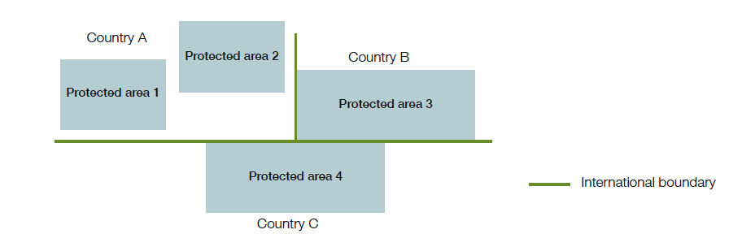
Transboundary Protected Areas (TBPA)
Characteristics
Clearly defined geographical space
Protected areas
Ecologically connected
Forms
Two or more contiguous protected areas across an international boundary [protected areas 3 & 4]
A cluster of protected areas located in two or more countries, but separated by areas that are not protected [protected areas 1, 2 & 3]
International boundaries
Form of cooperation
Notes:
Transboundary Protected Area (TBPA)
Defined in IUCN WCPA Best Practice Guidelines as "a clearly defined geographical space that includes protected areas that are ecologically connected across one or more international boundaries and involves some form of cooperation.”
Characteristics of TBPAs
Clearly defined geographical space - Comes directly from the IUCN definition of a protected area, which defines this as including ‘land, inland water, marine and coastal areas or a combination of two or more of these. ‘Space’ has three dimensions,e.g. as when the airspace above a protected area is protected from low-flying aircraft or in marine protected areas when a certain water depth is protected or the seabed is protected but water above is not: conversely subsurface areas sometimes are not protected (e.g. are open for mining). ‘Clearly defined’ implies a spatially defined area with agreed and demarcated borders. These borders can sometimes be defined by physical features that move over time (e.g. river banks) or by management actions (e.g. agreed no-take zones)’
Protected areas - As defined by IUCN: ‘a clearly defined geographical space, recognized, dedicated and managed, through legal or other effective means, to achieve the long-term conservation of nature with associated ecosystem services and cultural values’
Ecologically connected - Refers to ‘the flow of organisms and ecological processes’ between protected areas. Across an international boundary, the movement of species and the occurrence of ecological processes (biological, geochemical and physical) are enabled by the existence of portions of one or more common (shared) ecosystems in a TBPA. Shared ecosystem(s) usually imply certain physical proximity, and so ecologically connected protected areas located in two or more countries are normally close to or contiguous with each other.
International boundaries - Refers to the international boundaries between countries and specifically does not refer to boundaries between sub-national units.
Form of cooperation - Refers to any of the four models of cooperation in transboundary conservation that are practiced between relevant stakeholders from two or more countries.
Two Forms of TBPAs
Form 1: two or more contiguous protected areas across international boundaries. (Note that ‘contiguous protected areas across international boundary’, as defined in Glossary, indicate protected areas adjoining across international boundary)
Form 2: a cluster of protected areas located in two or more countries, but separated by areas that are not protected.
Note on revised terminology: the current definition differs from the older definition of TBPA in three ways:
It does not include protected areas across sub-national boundaries
It emphasizes ecological connections, which does not necessarily require physical contiguous area
It encompasses the revised IUCN definition of protected area, with focus on the long-term conservation of nature with its ecosystem services and cultural values, recognizing the landscape scale of conservation.

Slide 13
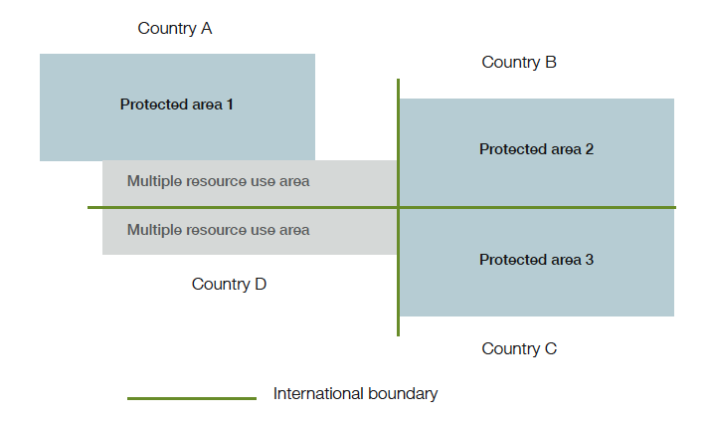
Transboundary Conservation Landscape and/or Seascape (TBCL/S)
Characteristics
Ecologically connected
Protected areas
Multiple resource use areas
International boundaries
Form of cooperation
Notes:
Transboundary Conservation Landscape and/or Seascape (TBCL/S)
Defined in IUCN WCPA Best Practice Guidelines as "an ecologically connected area that includes both protected areas and multiple resource areas across one or more international boundaries and involves some form of cooperation.”
Characteristics of TBCL/Ss
Similarities with TBPAs: (1) Ecologically connected, (2) Protected areas, (3) International Boundaries, (4) Form of cooperation.
New Concept: Multiple resource use areas - Refers to areas under governmental, communal, or private control, used for a variety of purposes (e.g. agriculture, forestry, aquaculture) and which are sustainably managed or managed in a way that is compatible with the conservation objectives of the protected area(s) within the TBCL/S.
The next slide discusses forms of TBCL/S.
Note on the revised terminology: The Transboundary Conservation Landscape and/or Seascape is most similar to the Transboundary Conservation and Development Area under the previous terminology, with two main differences:
The TBCL/S, like other TBCAs under the revised typology, excludes areas across sub-national boundaries, encompasses the IUCN definition of protected area, focuses on ecological connectivity, and includes conservation of ecosystems and ecosystem services.
The substitution of “landscape/seascape” for “conservation and development area” recognizes that the key feature of TBCL/S is the distinct character created by the interaction of people and nature over time, reflecting the definition of IUCN Category V Protected landscape/seascape.

Slide 14
Transboundary Conservation Landscape and/or Seascape (TBCL/S)
Forms
Two or more contiguous protected areas across an international boundary and including adjoining intervening land [protected areas 2 & 3, and multiple resource use area in country D]
A cluster of protected areas in two or more countries and the intervening land [protected areas 1, 2 & 3]
Protected area alongside a proposed protected area over the border
Protected area next to an area with sympathetic land use over the border
Notes:
Transboundary Conservation Landscape and/or Seascape (TBCL/S)
Forms of TBCL/Ss
Two or more contiguous protected areas across an international boundary and including adjoining intervening land [e.g. protected areas 2 & 3 and multiple resource use area in country D] (Note that ‘contiguous protected areas across international boundary’, as defined in Glossary, indicate protected areas adjoining across international boundary)
A cluster of protected areas in two or more countries and the intervening land [e.g. protected areas 1, 2 & 3 and multiple resource use area in country A]
Protected area alongside a proposed protected area over the border
Protected area next to an area with sympathetic land use over the border (Note that ‘sympathetic land use’, as defined in Glossary, indicates in the context of transboundary conservation, land management in one of the neighbouring countries that is compatible with conservation goals, and thus may form a TBCA with a protected area in another neighbouring country).

Slide 15
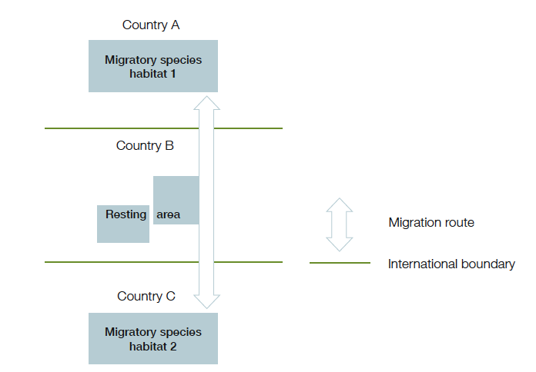
Transboundary Migration Conservation Area (TBMCA)
Characteristics
Wildlife habitats
Sustain
Populations of migratory species
International boundaries
Form of cooperation
Notes:
Transboundary Migration Conservation Area (TBMCA)
Defined in IUCN WCPA Best Practice Guidelines as “wildlife habitats in two or more countries that are necessary to sustain populations of migratory species and involve some form of cooperation.”
Characteristics of TBMCAs
Wildlife habitats - Natural and/or semi-natural areas populated by species of animal, plant and/or other types of organism and containing suitable living conditions for the species. In the context of a TBMCA, wildlife habitats should constitute the range of one or more populations of migratory species. ‘Range’ signifies ‘all the areas of land or water that a migratory species inhabits, stays in temporarily, crosses or overflies at any time on its normal migration route’
Sustaining populations - Provides for the maintenance of suitable ecological requirements for a migratory species
Migratory species - Refers to ‘the entire population or any geographically separate part of the population of any species or lower taxon of wild animals, a significant proportion of whose members cyclically and predictably cross one or more national jurisdictional boundaries.’’
TBMCAs do not have to contain protected areas.
International instruments
The Convention on the Conservation of Migratory Species (CMS) is the key global framework for TBMCAs.
The Convention on Biological Diversity (CBD) also addresses the needs of migratory species.
Forms: TBMCAs are complex habitats. They normally include:
Migratory species habitats in different countries
Resting areas or feeding areas
Migration routes
Different types of migration corridors are discussed on the next slide.
Note on the revised terminology: The term Transboundary Migration Conservation Area is used instead of the older Transboundary Migratory Corridor to better describe the different types of geographical and spatial areas relevant for migration, and the ecological requirements for migratory species that go beyond corridors, such as conservation of key habitat areas and intermediate stop-over habitats.

Slide 16
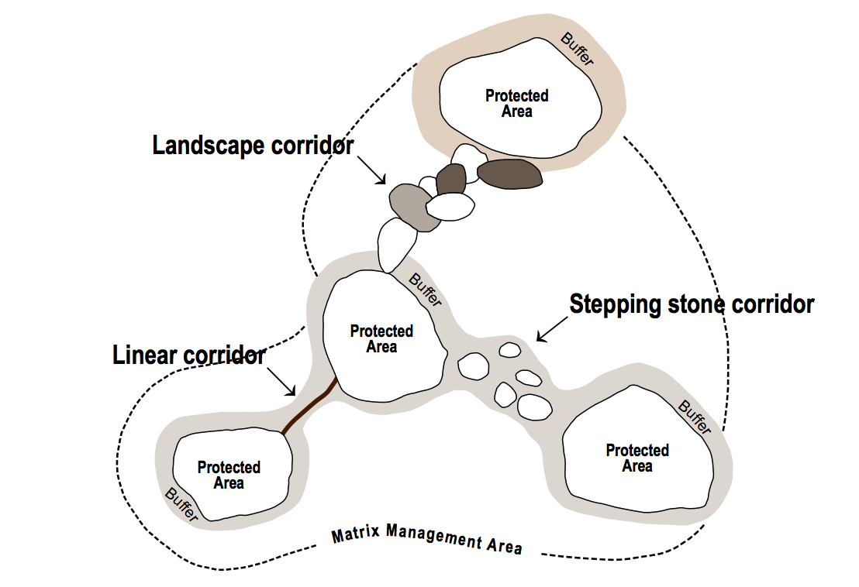
Transboundary Migration Conservation Area (TBMCA)
Types of Corridors
Contiguous linear corridor
Mosaic of interlinked landscapes
Stepping stones
Notes:
Diagram Credit: Chester and Hilty, 2010, p. 25; from Bennett (2004) IUCN Legal Aspects of Connectivity Conservation: A Paper (pg. 14–18)
Transboundary Migration Conservation Area (TBMCA)
Connectivity corridors
Allow movement of populations of species across international boundaries and increase potential range
Can build resilience in ecosystems and are important for climate change adaptation
Types of Corridors
Continuous linear corridor: e.g., river and riverside habitat, narrow forest strip
Landscape corridor: mosaic of interlinked landscapes
Stepping stones: small patches of habitat that enable species to move, e.g. bird feeding or resting grounds.

Slide 17
Comparison of Characteristics of TBCAs
Characteristics | Transboundary Protected Area | Transboundary Conservation Landscape and/or Seascape | Transboundary Migration Conservation Area
Cooperation across international boundary | Yes | Yes | Yes
Contains protected areas | Yes | Yes | Not necessarily
Contains areas that are not protected, but are sustainably managed | No | Yes | Not necessarily
Shared ecosystem(s) | Yes | Yes | Not necessarily
Relative physical proximity between units within a TBCA | Yes | Yes | Not necessarily
Transboundary cooperation in species/habitat management | Yes | Yes | Yes
Protection of migratory species is key reason for cooperation | Not necessarily | Not necessarily | Yes
Transboundary cooperation in management, local community relations, visitor management, security considerations | Yes | Yes | Not necessarily
Notes:
Photo credit: Nordfriesiche Wattenmeer ©Ralf Roletschek (CC BY-SA 3.0)
Comparison of characteristics of TBCAs
This slide provides a comparison of the different types of TBCAs. It may be printed and given to participants as a handout.
Comparison between the typology of TBCAs
Cooperation across international boundaries is found in all types of TBCAs.
Protected areas are necessary parts of Transboundary Protected Areas and Transboundary Conservation Landscapes/Seascapes. Transboundary Migration Conservation Areas may or may not contain protected areas.
Sustainably managed areas that are not protected areas are found in Transboundary Conservation Landscapes/Seascapes. They may or may not be part of Transboundary Migration Conservation Areas. Transboundary Protected Areas do not contain sustainably managed areas that are not protected.
Shared ecosystems are found in Transboundary Protected Areas and Transboundary Conservation Landscapes/Seascapes. They are not necessarily found in Transboundary Migration Conservation Areas.
Physical proximity between units within a TBCA is necessary for Transboundary Protected Areas and Transboundary Conservation Landscapes/Seascapes, but not Transboundary Migration Conservation Areas, which can take the form of stepping stones or resting areas for migratory birds.
Transboundary cooperation in species/habitat management is found in all forms of TBCA.
Protection of migratory species is necessary in Transboundary Migration Conservation Areas, but not necessarily other forms of TBCA.
Cooperation in day-to-day management, strengthening of local community relations, visitor management, and security considerations may be found in Transboundary Protected Areas and Transboundary Conservation Landscapes/Seascapes, but not necessarily Transboundary Migration Conservation Areas.

Slide 18
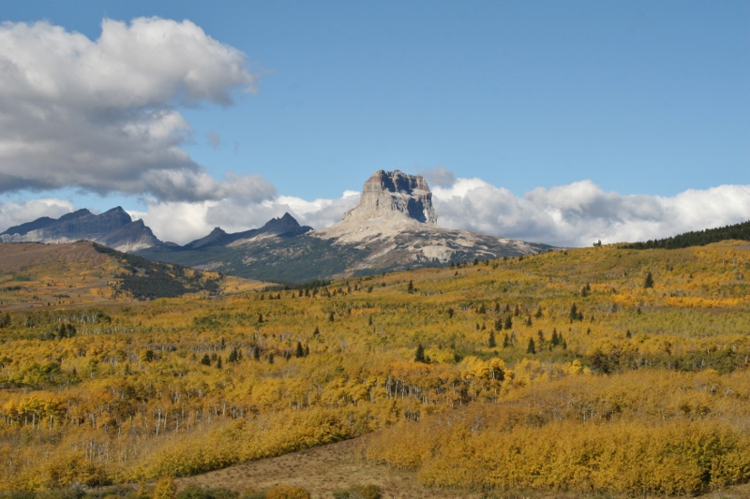
Special Designation: Park for Peace
Characteristics
Special designation that may apply to TBPA, TBCL/S, TBMCA
Celebrate endurance of peace
Promote and reinforce peaceful relations
Waterton-Glacier International Park for Peace in Canada and USA is the first Park for Peace in the world, established in 1932
Notes:
Photo Credit: Waterton-Glacier International Peace Park ©Maja Vasilijević
Special Designation: Park for Peace
Defined in IUCN WCPA Best Practice Guidelines as ”a special designation that may be applied to any of the three types of TBCAs, and is dedicated to the promotion, celebration and/or commemoration of peace and cooperation.”
Characteristics of Parks for Peace
Celebrates endurance of long-standing peaceful relations
Reinforces or promotes future peaceful relations
*Note: IUCN uses the term “Park for Peace” rather than “Peace Park”, recognizing that “Peace Park” can be used for situations not related to transboundary conservation, such as battlefield commemoration or protected areas entirely within one country.
Note on the revised terminology: Under the new typology, a Park for Peace can be applied to any of the three types of TBCAs, not just Transboundary Protected Areas (as was the case under the old terminology).

Slide 19
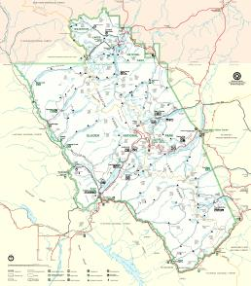
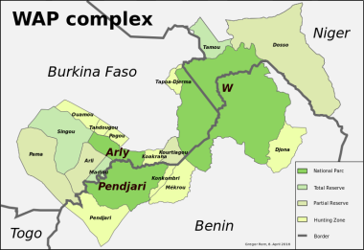
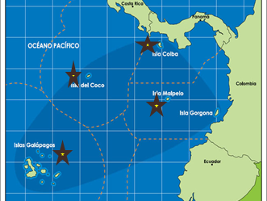
Typology of TBCAs: Examples
Transboundary Protected Area & Park for Peace
Transboundary Conservation Landscape/Seascape
Transboundary Migration Conservation Area
Waterton-Glacier International Peace Park (Canada/US)
W-Arly-Pendjari Complex (Benin, Burkina Faso, Niger)
Eastern Tropical Pacific Marine Corridor (Colombia, Panama, Ecuador, Costa Rica)
Notes:
Photo credit: Nordfriesiche Wattenmeer ©Ralf Roletschek (CC BY-SA 3.0)
Map Credit: Glacier National Park: National Park Service (public domain); Eastern Tropical Pacific Marine Corridor ©Marpelo Foundation; WAP complex ©Gregor Rom (CC BY-SA 4.0)
Typology of TBCAs: Examples
The following slides provide detailed examples of different types of TBCAs.
The slides and accompanying notes may be printed out for participants as handouts.
Alternatively, case studies from the participants’ regions or countries can be substituted for these examples.

Slide 20
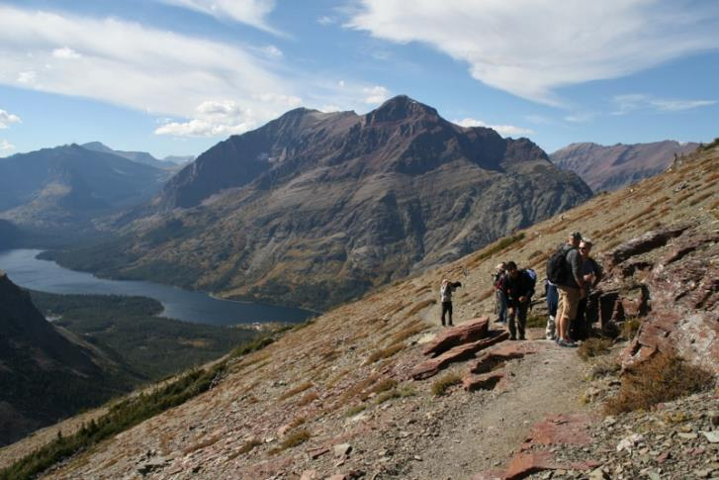
Waterton-Glacier International Peace Park: a TBPA
Established in 1932 to to celebrate the long-lasting peaceful relations between the two adjoining countries
Consists of Waterton Lakes National Park (Canada) and Glacier National Park (USA) (contiguous protected areas spreading across an international boundary)
Highly collaborative and continuous cooperation based on sound personal relationships among the staff and partners
Notes:
Photo credit: Waterton-Glacier International Peace Park ©Maja Vasilijević
Map Credit: Glacier National Park: National Park Service (public domain)
Waterton-Glacier International Peace Park: a TBPA
Waterton-Glacier is considered to be the first TBPA and Park or Peace in the world, established in 1932. Its establishment was facilitated by Rotary Clubs (non-governmental organization) from Alberta, Canada, and Montana, USA, and officially supported by both governments. The TBPA is firmly based upon an international treaty made between the two countries. The site was added to the UNESCO World Heritage List as a transboundary site in 1995.
The site does not have a formal joint management plan in place, but the cooperation is continuous and highly collaborative, based on sound personal relationships among the staff and partners. Examples of cooperation areas include:
A joint programme for invasive plant species
Search and rescue operations
Firefighting
Communication regarding public safety warnings, weather conditions, and trail closures
One-time events linked to anniversaries.
Main coordinators of transboundary cooperation are national governments; US National Park Service and Parks Canada. At the ecosystem level that extends beyond the boundary of the TBPA, a broader cooperation between diverse stakeholders exists under the ”Crown Management Partnership”, including federal, aboriginal, provincial and state agencies or organizations that are responsible for land, environment or resource management within the Crown of the Continent Ecosystem. Waterton Lakes and Glacier national parks play central role in this Partnership, and considerable collaboration is carried out through it.
Waterton-Glacier International Peace Park is a valuable example of how private sector support can contribute greatly to the long-lasting nature conservation. Also, the informal relationship between the two national parks’ agencies demonstrates effective cooperative management and quick response to a dynamic set of transboundary challenges.
Supplemental reading:
Mihalic, D. (2012). Waterton-Glacier International Peace Park: Observations and Retrospection on Cooperation Issues. In: Quinn, M., Broberg, L. and Freimund, W. Parks, Peace, and Partnership. Global Initiatives in Transboundary Conservation. University of Calgary Press, Calgary, Canada.
Crown Managers Partnership (2015). History. http://www.crownmanagers.org
Konstant, W.R., Locke, H. and Hannah, J. (2005). The Waterton-Glacier International Peace Park: The First of Its Kind. In: Mittermeier, R.A., Kormos, C.F., Mittermeier, C.G., Robles Gil, P., Sandwith, T. and Besançon, C. Transboundary Conservation. A New Vision for Protected Areas. Mexico: CEMEX-Agrupación Sierra Madre-Conservation International.
Hands Across Borders. Profiles of Participating Transboundary Conservation Initiatives: Wateton Glacier International Peace Park. http://naturalresourcespolicy.org/projects/transboundary-conservation.php

Slide 21
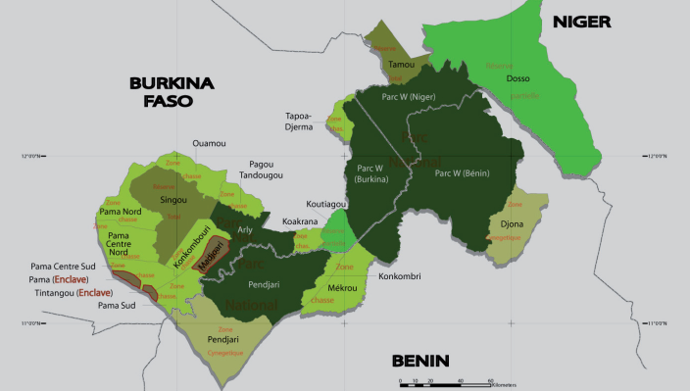
W-Arly-Pendjari Complex: a TBCL
National parks (‘W’ in Benin, Burkina Faso and Niger, Arly in Burkina Faso and Pendjari in Benin), wildlife reserves and intervening land form this TBCL of about 31,000 sq. km
Tripartite agreement signed in 2008
Transboundary conservation heavily dependent on international donor support
Human poverty in the parks’ periphery – the need to combine economic and conservation goals
Notes:
Map credit: WAP complex ©Gregor Rom (CC BY-SA 4.0)
W-Arly-Pendjari Complex: a TBCL
W, Arly, Pendjari Complex consists of national parks, partially wildlife reserves and neighbouring areas and represents a typical TBCL type of TBCA. It spans more than 31,000 sq. km shared by Benin, Burkina Faso and Niger. In 2002, the trilateral complex was proclaimed as Africa’s first transboundary UNESCO Biosphere Reserve (called ‘W’ Region). The area hosts more than 60 per cent of West Africa’s elephants, some of the last viable populations of big carnivores and the last West African giraffes.
Discussions on joint conservation planning started already in the 1970s, while in years to come common activities have been initiated in park management (particularly the fight against poaching), tourism, environmental education and research. A tripartite agreement, providing for common management bodies, was signed in 2008.
From social perspective, the site is characterize with extreme human poverty in the park’s periphery, hence the need to combine economic and conservation goals in the park’s management. The first multi-million EUR transboundary project ECOPAS, initiated in 2003, worked towards the creation of trust between bordering populations and protected area auhtorities, among other pressing issues. While transboundary cooperation has been slowly developing, the site’s relative success has largely been made possible due to strong international funding and remains heavily dependent on foreign support.
Supplemental reading:
Michelot , A. with Ouedraogo, B. (2009). Transboundary Protected Areas: Legal Framework for the W Transboundary Biosphere Reserve (Benin, Burkina Faso, Niger). (IUCN-EPLP No. 81). http://cmsdata.iucn.org/downloads/w_biosphere__en.pdf
Dramé-Yayé, A., Daouda Boubacar, D. and Koudénoukpo Biao, J. (2007). The ”W” International Peace Park: Transforming Conservation and Conflict in West Africa. In: Ali, S.H. Peace Parks. Conservation and Conflict Resolution. Cambridge, Massachusetts and London, England: The MIT Press.
Garreau, J.M., Kane, C. T., Mahamadou, S. and De Winter, J. (2015). Box 22: The W, Arly and Pendjari: a transfrontier complex to consolidate. In: Vasilijević, M., Zunckel, K., McKinney, M., Erg, B., Schoon, M., Rosen Michel, T. Transboundary Conservation: A systematic and integrated approach. Best Practice Protected Area Guidelines Series No. 23, Gland, Switzerland: IUCN.

Slide 22
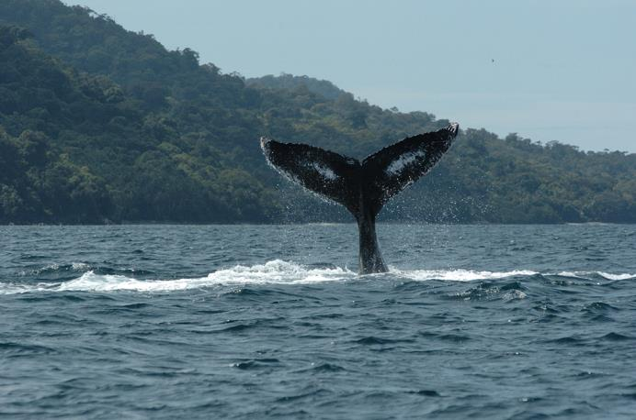
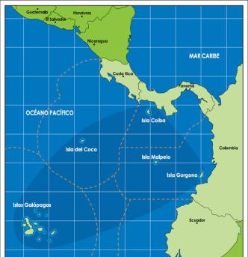
Eastern Tropical Pacific Marine Corridor: a TBMCA
Established in 2004 by signing of a ministerial-level declaration
Collaboration for conservation and sustainable use of 5 marine protected areas surrounding the islands Malpelo and Gorgona (Colombia), Coiba (Panama), Galapagos (Ecuador), and Cocos (Costa Rica)
Impetus for cooperation by UNESCO
Sustaining marine migratory species
Notes:
Photo credit: Humpback whale (Megaptera novaeangliae). Gorgona National Park, Colombia. ©Fundación Yubarta, www.cmarpacifico.org
Map credit: Hands Across Borders. Profiles of Participating Transboundary Conservation Initiatives: Eastern Tropical Pacific Seascape. http://naturalresourcespolicy.org/projects/transboundary-conservation.php
Eastern Tropical Pacific Marine Corridor: a TBMCA
The Eastern Tropical Pacific Marine Corridor (CMAR) is a transboundary and regional initiative for the conservation and sustainable use of the region’s marine and coastal resources. It includes an area of more than 1.3 million sq. km consisting of five marine protected areas (MPAs): Cocos Island National Park (Costa Rica), Galapagos National Park (Ecuador), Malpelo Fauna and Flora Sanctuary (Colombia), Gorgona National Park (Colombia), and Coiba National Park (Panama). The area is important for marine biodiversity, high endemism and provides natural conditions to sustain migratory species.
CMAR was established in 2004 when the Ministers of Environment of four participating countries signed a Declaration of San José (legally non-binding agreement). Valuable impetus was provided by the UNESCO World Heritage Programme which identified a need of cross-border management of marine World Heritage Sites and their connectivity. Considering that four out of five MPAs in CMAR (all except Gorgona) are World Heritage Sites, this was perceived as a positive sign to move forward and establish cooperation in management of the MPAs.
Complex governance structure of CMAR includes:
Regional Ministerial Committee that support the CMAR politically
Pro Tempore Presidency that rotates every 3 years between the countries
Pro Tempore Technical Secretariat that also rotates every 3 years between the countries and has the mandate to facilitate the actions requested by the two Committees (Regional Ministerial and Regional Technical)
Regional Technical Committee that advises and prepares technical proposals to support the CMAR actions
National Commissions that coordinate actions at national level
Working Groups that conduct technical actions on biodiversity, fishing, responsible tourism, control and surveillance.
Key areas of cooperation include:
Nature conservation
Sustainable use of marine biodiversity focused on tourism and fishing
MPAs management
Common regional ecosystems
Endemic and endangered species
Building capacities and training
Inter-sectoral stakeholders participation.
Supplemental reading:
www.cmarpacifico.org
Hands Across Borders. Profiles of Participating Transboundary Conservation Initiatives: Eastern Tropical Pacific Seascape. http://naturalresourcespolicy.org/projects/transboundary-conservation.php

Slide 23
Discussion
What Transboundary Conservation Areas do you have experience with? What type of TBCAs are they, using the IUCN WCPA typology? What models of cooperation do you use?
  …
Notes:
Photo credit: Nordfriesiche Wattenmeer ©Ralf Roletschek (CC BY-SA 3.0)
Discussion
Use this slide to start a discussion.
Ask learners about their experience with diverse types of TBCAs.
What TCBAs do you have experience with?
What type of TBCAs are they, using the IUCN WCPA typology?
Are any of the examples a combination of several types of TCBAs?
Ask learners about the models of cooperation that they have experience in.
What models of cooperation do you use?
Have you used a combination of models of cooperation?
Process:
Option 1: Ask learners in advance to prepare a slide on a site in which they worked. Include the slides in this presentation.
Option 2: Go around the room and ask each learner to describe an area in which they worked. Make notes on this slide, or on a whiteboard or flipchart.
Questions and answers
Following the discussion, ask learners if they have any questions on the lesson, or on anything the other learners have said.

Slide 24
Transboundary Conservation Areas
End of Lesson 2
Notes:
Photo credit: Nordfriesiche Wattenmeer ©Ralf Roletschek (CC BY-SA 3.0)

